Slide 1
NHLBI Population Studies Workshops:
Facilitating Team Science
Lorraine M. Silsbee, MHS
Epidemiology Branch
Division of Cardiovascular Sciences
National Heart, Lung, and Blood Institute
National Institutes of Health
SCiTS
August 7, 2014

Slide 2
Outline
NIH/NHLBI
Description of Studies
Description of Workshop
Evaluation
Workshop Outcomes

Slide 3


Slide 4
NIH: 27 Institutes and Centers
NIAID
NINR
OD
NCI
NIAMS
NCCAM
NIEHS
NEI
NIMH
CIT
NIDA
NLM
NINDS
CC
NIDDK
NIBIB
NCMHD
NHLBI
NHGRI
NIDCR
NIA
NIDCD
NIAAA
NICHD
NIGMS
FIC
CSR
NCATS
= Extramural only
Notes:
From NIH 101 slide deck

Slide 5
The National Heart, Lung, and Blood Institute
Third largest Institute at NIH
Supports independent research and career training of new and established researchers through research awards in heart, lung, blood and sleep disorders.

Slide 6
Mission of NHLBI Epidemiology Branch
Identify distributions and trends in heart, lung, blood, and sleep diseases and their risk factors in the U.S.
Identify new risk factors for HLBS disorders
Apply findings from bench research to population settings and vice versa
Identify potential interventions

Slide 7
Types of Epidemiology Studies
Longitudinal cohort studies
Family-based studies
Gene-environment studies

Slide 8
NHLBI Epidemiology Studies
Single site studies
Multi-site studies
Multiple age, race, ethnic groups
Sample size: 5,000 – 16,000 participants
Wide breadth of data collection (including genomic data); biorepositories
Thousands of publications/findings
Always more to learn

Slide 9
Team Science NHLBI Population Studies Workshops
NHLBI sponsored 3 workshops
2008: CARDIA, Framingham, MESA
2010: ARIC, Women’s Health Initiative
2013: Jackson Heart Study, Strong Heart Study

Slide 10



Population Studies Workshop (2008) Featured Studies
Framingham Heart Study (32 exams original cohort)
Predominantly Caucasian
5,209 participants ages 28 – 62, recruited in 1948- 1953
3 generations of offspring cohorts (9,219 individuals)
Single site: Framingham, Massachusetts
Multi-Ethnic Study of Atherosclerosis (MESA) (5 exams)
Multi-ethnic: White, Black, Hispanic, Chinese
6,814 participants ages 45-84 at baseline
Six field sites: New York, Maryland, Minnesota, North Carolina, Illinois, California
Coronary Artery Risk Development in Young Adults (CARDIA)
(8 exams)
African American and White
5,115 participants ages 18-30 at baseline
Four field sites: Alabama, Illinois, Minnesota, California

Slide 11

Population Studies Workshop (2010) Featured Studies
Atherosclerosis Risk in Communities (ARIC) (5 exams)
Bi-racial (25% African American)
15,792 participants; ages 45-74 at baseline
Four sites: Maryland, North Carolina, Mississippi, Minnesota
Women’s Health Initiative
Multi-ethnic (82% white) (age 50-79 at baseline)
68,132 in clinical trials component (annual exams 1993 – 2005)
93,676 in observation component (two exams at enrollment and year 3)
Forty field centers (now 4 regional centers)

Slide 12


Population Studies Workshop (2013) Featured Studies
Jackson Heart Study (3 exams)
5,301 African Americans from Jackson, MS area
Ages 35 – 84 (family cohort age 21+)
Strong Heart Study (5 exams including family study)
4,549 American Indian men and women
Ages 45-59
Family study: 3,776 American Indian men and women ages 15 - 91

Slide 13
Workshop Objectives
To provide early career researchers opportunities to:
Learn about the research conducted and data collected in these studies
Develop a manuscript proposal using data from the studies presented
Collaborate with other investigators from these studies and with others at this Workshop

Slide 14
Publicizing the Workshops
NIH RePORTer (Research Portfolio Online Reporting Tools) to identify potential applicants NIH-wide
Public health and relevant health-related associations
Mainly email advertising
Workshop website

Slide 15
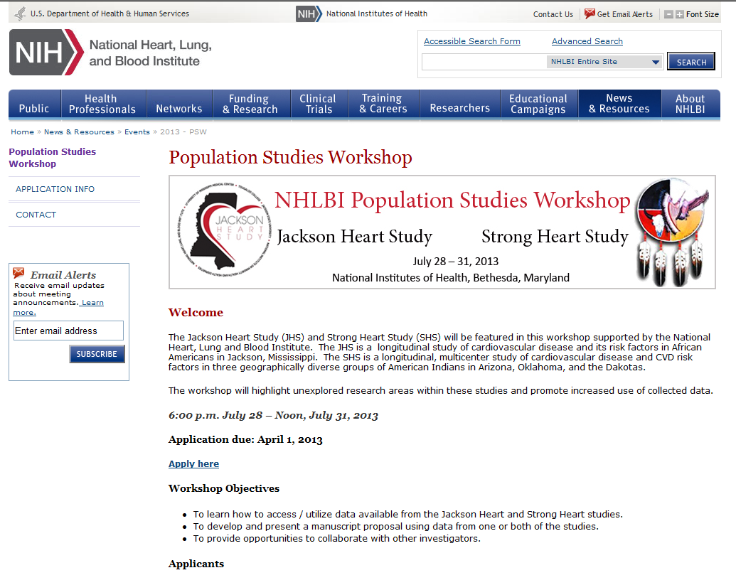
Workshop Website

Slide 16
Application Process
Statement of interest
Sponsor letter
NIH Biosketch
Draft Manuscript Proposal

Slide 17
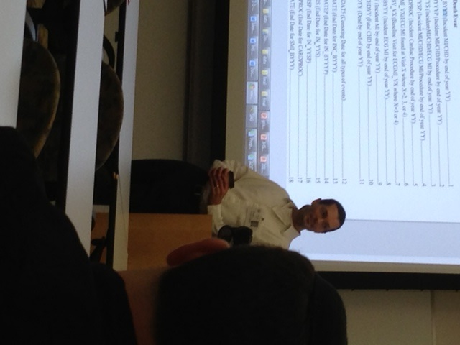
Workshop Website
Agenda
Presentation slides
Study-specific information
Design and methods publications
Examination components
Manuscript template

Slide 18
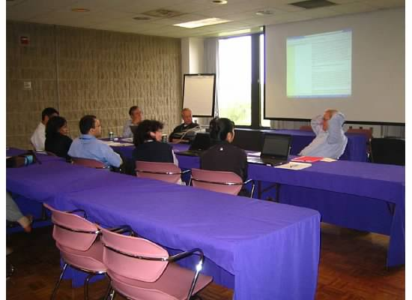
Workshop Topics
Overview of studies and policies
Accessing and using data sets
Overview of available data
Opportunities for collaboration
Topic-oriented breakout groups
Draft and present manuscript proposals

Slide 19
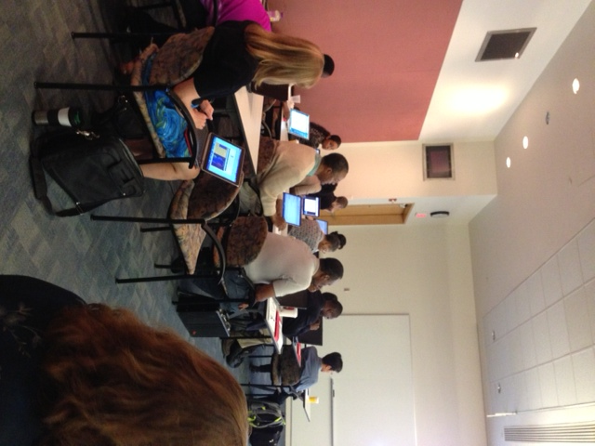
Workshop Participants
Attendance ranged from 46 – 59 participants
Career levels: graduate student; post-doctoral; junior faculty
Overall
40% MD
46% Ph.D
9% MD/PhD
5% Other

Slide 20
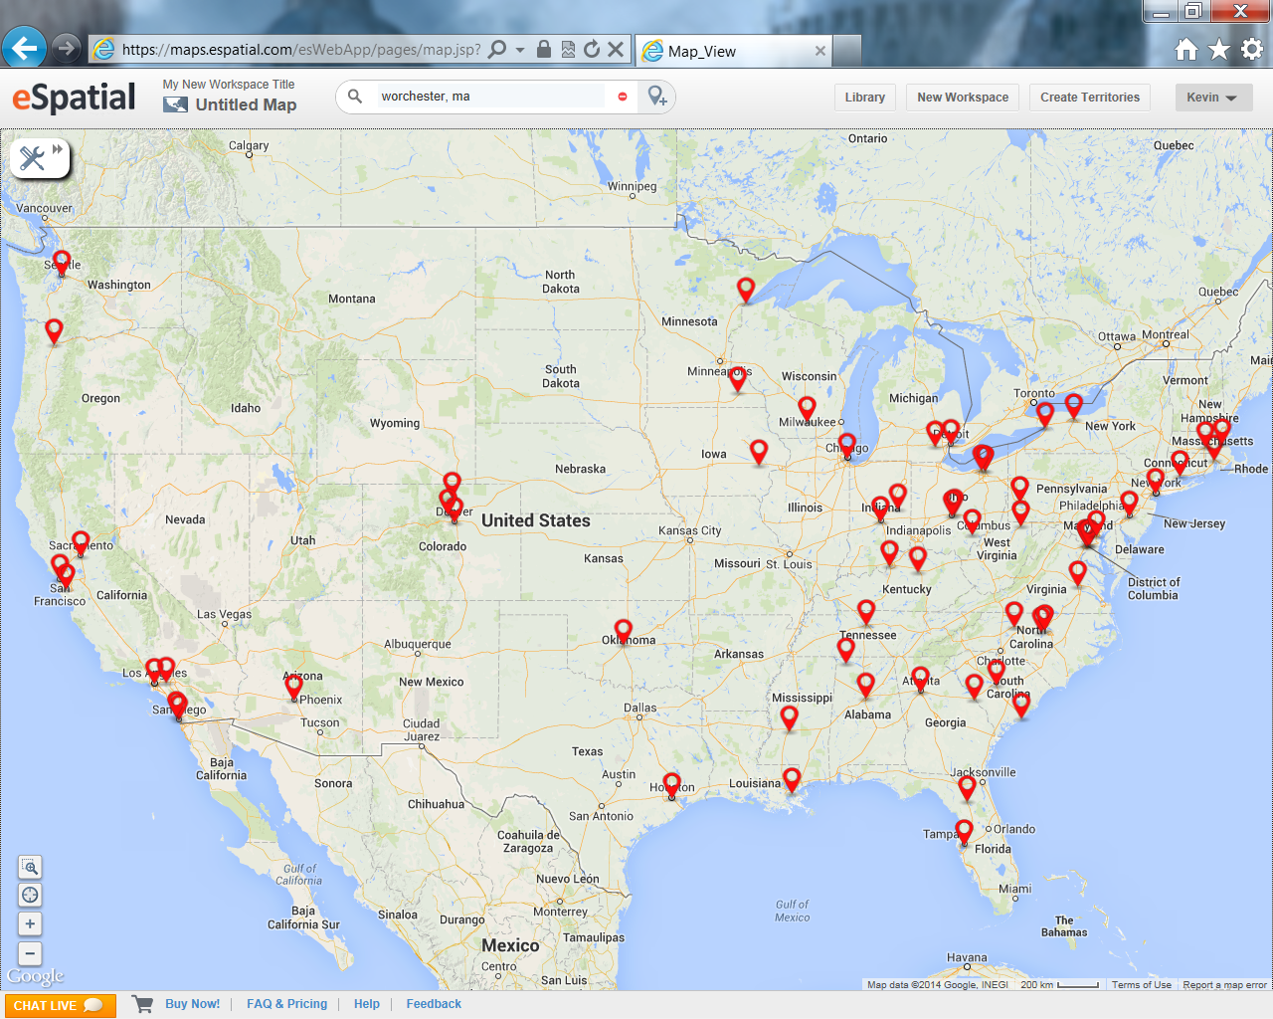
Distribution of Workshop Participants
Not on map: participants from Hawaii and Germany

Slide 21
Workshop Evaluation
Survey Monkey
Online survey tool
Used to design, collect and analyze responses
Real-time feedback (comments helped us make schedule adjustments on the spot)
Evaluation survey open after workshop for further feedback

Slide 22
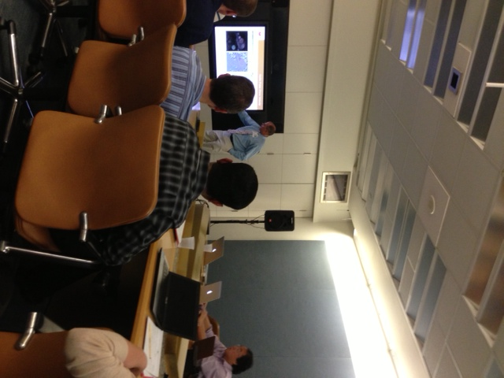
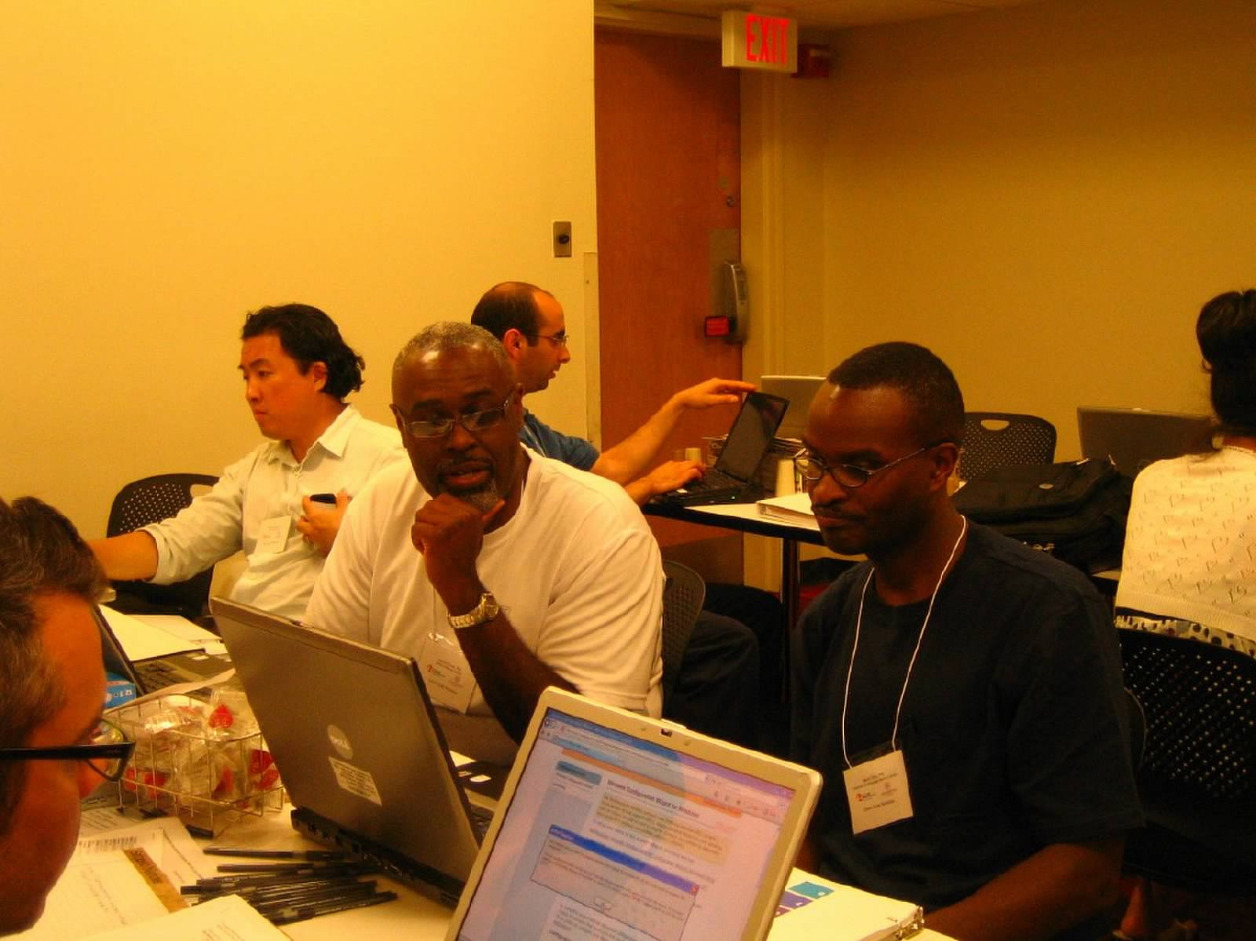
Evaluation Collected Information On:
Participant demographics
Feedback on:
Each session
Overall course design
Future plans

Slide 23
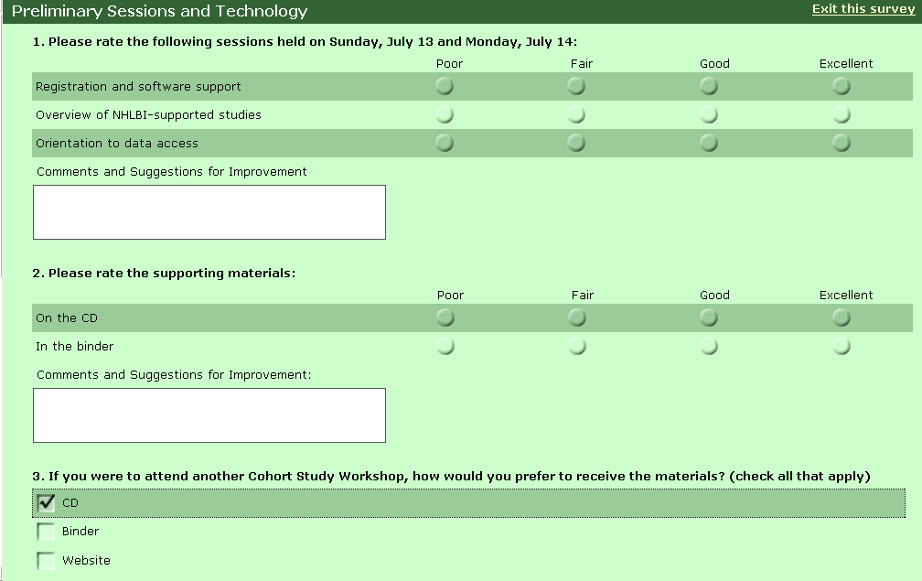
Screen Shot

Slide 24
Workshop Outcomes
39 Publications (from 2008, 2010 workshops)
9 first author
30 co-author
20 publications with more than one author from the same workshop
2013 Workshop:
22 manuscript proposals; 1 early career grant application
Funded early career grant application
Finalist – AHA Stamler Research Award for New Investigators

Slide 25
Likelihood of submitting future manuscript or ancillary study proposal

Slide 26
Comments
“Came with an idea, left with a concrete plan of action”
“Ideal opportunity for young investigators to get their foot in the door and advance their careers”

Slide 27
Comments
“…breakouts are where the real work happens…significant breakthroughs in thinking or next steps occur even after brief exchanges…”
“Amazed at willingness of senior investigators to collaborate with younger investigators. .. Truly pivotal for my career development.”

Slide 29
Team Science
Workshops fostered collaboration and team science
“De-mystified” studies/access to data
Actively recruited collaborators
Promoted development of new ideas
Promoted collaboration between senior investigators and early career researchers
Promoted collaboration between workshop participants
Collaborations – long lasting (we hope)

Slide 30
Questions??

